Slide 1
Business Case Study

Slide 2
Overview
You will have received 3 datasets containing account, customer, and transaction level data. We are interested in understanding the process you take in answering the following questions. Please provide the answer and an explanation where applicable. Questions are broken into two categories:
Data Manipulation Queries
These are questions designed to test your understanding of data manipulation and preparation. Please provide the answer to the question on the Data Manipulation answer slide (slide 5) and provide your queries in the corresponding Data Manipulation queries slides. You can use any programming language you would like to complete the task.
Business Case
These questions are designed to test your critical thinking, logic, and problem solving skills. Please document your approach and present your findings as if you were presenting to an executive (non-technical) business partner. You can use any programming language you would like to complete the task.

Slide 3
The Task -
Data Manipulation
What branch has the most number of customers?
How old is the oldest customer as of 2019-07-01
How many accounts does the oldest customer have?
How many transactions went to Starbucks in April?
How much was spent on Starbucks in April?
Hypothesis Testing: Is the average spend at Starbucks (statistically) significantly different in April compared to June?
Which date exhibited the highest average spend above trend at Starbucks (based on a 10-period moving average, ignoring missing dates)?

Slide 4


Slide 5
Data Manipulation Query Answer Summary Page
What branch has the most number of customers?
ANSWER: (Branch no 1029)
How old is the oldest customer as of 2019-07-01?
ANSWER: (106 years)
How many accounts does the oldest customer have?
ANSWER: (2)
How many transactions went to Starbucks in April?
ANSWER: (395)
How much was spent on Starbucks in April?
ANSWER: (1720)
Hypothesis Testing: Is the average spend at Starbucks (statistically) significantly different in April compared to June?
ANSWER: (The average spend those two months is not statistically different. Failed to reject the null hypothesis)
Which date exhibited the highest average spend above trend at Starbucks (based on a 10-period moving average, ignoring missing dates)?
ANSWER: (2018-06-28 07:33:00+00:00)

Slide 6
Data Manipulation Query 1: Branch with most customers
#Question1
#import dataset
df = pd.read_csv('BusinessCase_Accts.csv')
df.info()
df.head(n=5)
df.describe()
df.shape
#group branches by branch number and take count of customers by customer id,
m = df.groupby(['branchNumber',])['cust_id'].count()
m.head(5)
#convert the resulting numpy series back to a dataframe
df = pd.DataFrame({'branchNumber':m.index, 'NumberofCust':m.values})
df.head(5)
#sort the resulting dataframe by number of customers
df.sort_values(by=['NumberofCust'], inplace=True, ascending=False)
df.head(5)
#subset the top value of BranchNumber as the branch with the highest number of customers
df.iloc[0,0]
#(Answer = Branch 1029 with 302 customers)

Slide 7
Data Manipulation Query 2: Oldest customer as of 2019-07-01
#Question2
import datetime
#import data
df = pd.read_csv('BusinessCase_Custs.csv')
#convert date of birth column to datetime
df['birthDate'] = pd.to_datetime(df['birthDate'])
df.info()
#define the end date 2019-07-01 and format to date format
edate = '172019'
end_date = datetime.datetime.strptime(edate, '%m%d%Y')
#assign end date to a column
df['Enddate'] = end_date
df.head()
#get a new column Age, with the difference between the birthdate and end date in years
df['Age'] = df['Enddate'] - df['birthDate']
df['Age']=df['Age']/np.timedelta64(1,'Y')
df.head(n=5)
#sort the dataframe by the age column and select the topage as the age of the oldest customer
df.sort_values(by=['Age'], inplace=True, ascending=False)
df.iloc[0,14]

Slide 8
Data Manipulation Query 3: Oldest customer number of accounts
#Question3
#for the oldest customer, df['id'] = fe51c153-fbec-4b64-9b00-2530035ef0e1_522519ff-5e56-4d8a-9888-560f2cde4938
#the id was obtained from the previous calculation of the customer age
data1 = pd.read_csv('BusinessCase_Accts.csv')
data1.head(n=5)
list(data1.columns)
#where data from dataset where the cust_id is equal to the cust_id of the oldest customer
df7 = data1[data1['cust_id'] == 'fe51c153-fbec-4b64-9b00-2530035ef0e1_522519ff-5e56-4d8a-9888-560f2cde4938'].head(5)
df7
#find the unique number of account numbers that belongs the cust_id
NumAccount = df7['id'].nunique()
NumAccount

Slide 9
Data Manipulation Query 4: Transactions to Starbucks
#Question4
#import data
df = pd.read_csv('BusinessCase_Tx.csv')
#convert transaction date column to datetime
df['originationDateTime'] = pd.to_datetime(df['originationDateTime'])
#create a new column with only the month of the transaction date
df['month_of_date'] = df['originationDateTime'].dt.month
df.head(n=5)
#subset required columns of the dataset
df5 = df[['description', 'currencyAmount', 'originationDateTime', 'month_of_date','categoryTags']]
df5.head(n=5)
#select data where description has Starbucks in the month of April
df6 = df5[(df5['description'].str.match('STARBUCKS')) & (df5['month_of_date'] == 4)]
df6.head(n=5)
#count number of transaction description with starbucks
tx = df6['description'].count()
print(tx)

Slide 10
Data Manipulation Query 5: Dollars spent at Starbucks
#Question5
#import data
df = pd.read_csv('BusinessCase_Tx.csv')
#convert transaction date column to datetime
df['originationDateTime'] = pd.to_datetime(df['originationDateTime'])
#create a new column with only the month of the transaction date
df['month_of_date'] = df['originationDateTime'].dt.month
df.head(n=5)
#subset required columns of the dataset
df5 = df[['description', 'currencyAmount', 'originationDateTime', 'month_of_date','categoryTags']]
df5.head(n=5)
#select data where description has Starbucks in the month of April
df6 = df5[(df5['description'].str.match('STARBUCKS')) & (df5['month_of_date'] == 4)]
#Calculate Amt spent on Starbucks for the month of April
Amt = df6['currencyAmount'].sum()
print(Amt)

Slide 11
Data Manipulation Query 6: Hypothesis Test - Starbucks April and June statistical significance spend comparison
#Question6
import scipy.stats as stats
#Calculate avg spend at starbucks in April
Aprilspend = df6['currencyAmount']
Aprilmean = df6['currencyAmount'].mean()
print(Aprilmean) # = 4.36
#Calculate avg spend at starbucks in June
df6 = df5[(df5['description'].str.match('STARBUCKS')) & (df5['month_of_date'] == 6)]
df6.head(n=5)
Junespend = df6['currencyAmount']
Junemean = df6['currencyAmount'].mean()
print(Junemean) # = 4.50
#Check the statstical significance of the two means - hypothesis testing
#Null hypothesis: The means of the average april spend and average june spend are the same.
stats.ttest_ind(a= Aprilspend,
b= Junespend,
equal_var=False)
#Ttest_indResult(statistic=-1.008555214726324, pvalue=0.3135027717110388)
#we used a two-tailed t-test since the two means are sample means
#The test yields a p-value of 0.3135, which means there is a 33% chance we'd see sample data this far apart if the two groups tested are actually identical.
#we using a 95% confidence level. We would fail to reject the null hypothesis,
#since the p-value is greater than the corresponding significance level of 5%.

Slide 12
Data Manipulation Query 7: Highest average spend above trend at Starbucks (based on a 10-period moving average, ignoring missing dates)
#Question7
#import data
df = pd.read_csv('BusinessCase_Tx.csv')
#convert to datetime and match transactions with the starbucks description
df['originationDateTime'] = pd.to_datetime(df['originationDateTime'])
df2 = df[df['description'].str.match('STARBUCKS')]
#select desired columns from dataset
df3 = df2[['description','originationDateTime', 'currencyAmount']]
df3.head(n=5)
#calculate rolling mean on the currency amount and store values in a new column
df3['MA_10'] = df3['currencyAmount'].rolling(window=10).mean()
df3.head(n=15)
#sort values of rolling mean
df3.sort_values(by=['MA_10'], inplace=True, ascending=False)
df3.head(n=5)
#select the top value of date column in the dataset as the date with the highest average
df3.iloc[0,1]
#date with that exhibited the highest average spend above trend at
#Starbucks (based on a 10-period moving average, ignoring missing dates)
#is 2018-06-28 07:33:00+00:00

Slide 13
2
Business Case

Slide 14
The Task
Business Case
Use the data provided to answer the following questions:
We are planning to launch a new product focused on a specific merchant category (e.g. travel credit card). Which specific merchant category would you like to focus on for this new product? Please explain your rationale for this category incorporating both the insights derived from the data and other concepts where you see fit.
Identify and describe various segments of customers within the data. Consider applying segmenting/clustering techniques to aid in the development of your answer.
Of the segments that you created in question 2, which specific segment would you like to target for this new product? Why would you target them? What are the potential challenges/risks to consider when targeting this segment vs. others?

Slide 15
Approach
The approached employed in answering the case study questions is outlined below;
First, make some assumptions about the questions
Identify the dataset/ or columns needed for the analytics.
Ask the needed question for use in the analysis
Perform data manipulations if needed to improve answer to questions(join or merge, column deletion/ addition)
Joined the datasets(Customer and Transactions)
Apply analytic techniques to identify the answer to the questions
Create visualizations to identify trend and to provide answers to the questions.
Make conclusion on the assumptions and identify the correct answers
If no definite answered is obtained, generalizations about the data insight is made

Slide 16
3
Executive Presentation (Business Case Answers)

Slide 17
Executive Summary
Most of the transactions and money spent happened in the income and transfer category
The merchant categories spending was seasonal
Focusing on the transfer category I proposed a banking transfer app as the new product
The amount of money earned correlates with the spending
The Customers can be segmented using different variables – we used income and relationship status
K-means clustering was effective in correctly segmenting the customers based on available data
Customer segments can be successfully targeted based on the clusters and features of the new product.

Slide 18
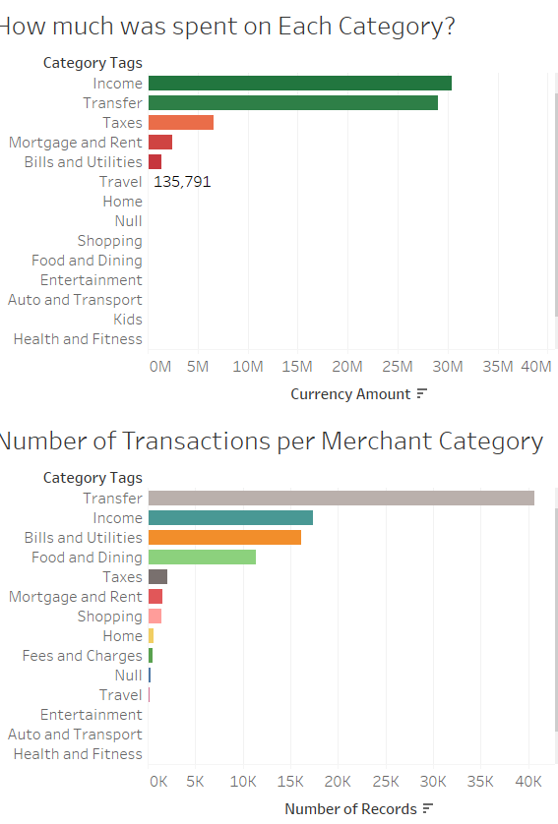
Presentation of Findings (Question 1)
For the launching of the new product, I would like to focus on the ‘Transfer’ merchant category and launch a Money transfer application for easier transfer.
A successful product launch depends on understanding customer needs and demographics and timing the launch of the product. Customer behavior affects what is bought by the customer and spending habit may be seasonal based on customer needs.
From our dataset, we discovered that most of the transaction occurred in the merchant category income and transfer. Logically we should focus on those categories for our product launch.
Transaction amount may not be enough in getting an understanding of merchant categories. Amount of transaction helps determine if the categories have a lots of customers that will buy the products.

Slide 19
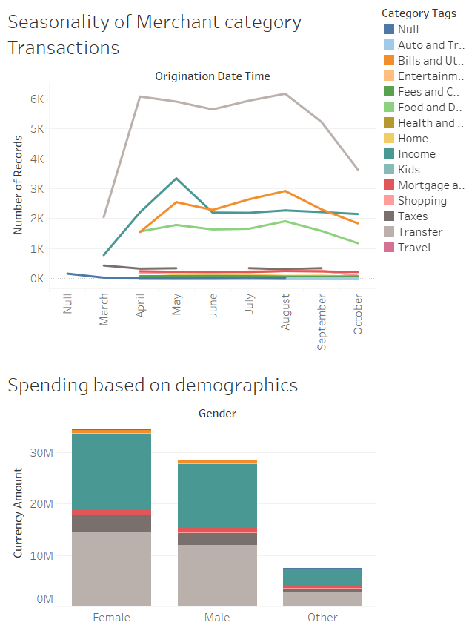
Another factor that will help in deciding on the category of focus is the seasonality of the products. Most of the categories we analyzed in the previous diagram showed seasonality in the number of transactions.
Timing should be considered when deciding the category to focus on as shown in the graph.
Demography of transaction records also plays a strong role in making product decisions. Our data showed that the given demographics showed a similar pattern on the amount they spend on each category of transactions.

Slide 20
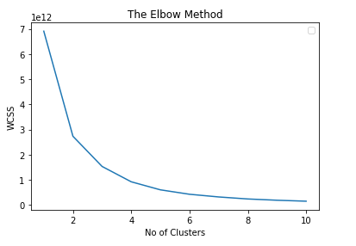
The clustering was performed with the K-Means clustering algorithm after preprocessing the dataset.
K-Means clustering is an algorithm used in unsupervised learning applications like customer segmentation used in our analysis. This is used since we do not know the target variable and had to segment the customers into groups based on available variables.
K-means clustering is a faster algorithm than hierarchical algorithm for large dataset ant it produces tighter clusters than the hierarchical algorithm.
The first step in the application of K-Means clustering is to obtain the optimal number of clusters based on the dataset. The diagram on the left depicts a plot using the elbow method, with the main turning point of the line at Cluster number 4. Therefore, we used five(5) clusters in our segmentation.

Slide 21
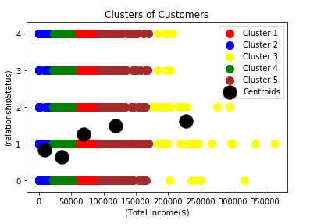
Based on our clustering algorithm and the available variables in the dataset, we segmented our customers into 4 clusters
Cluster 1 - customers that earn a low income
Cluster 2- Customers that a earn the lowest income
Cluster 3 - Customers that earn a very high income
Cluster 4 - Customers that earn a lower income
Cluster 5 - Customers that earn the lowest income
The customer segments can be found in each relationship status, but the high earners are mostly seen in the single and divorced ones.
The total income can be an indicator of the customer purchasing power, but it does not explain what the total expense of the customer may be. The total expense recurrently incurred by a customer will affect his purchasing power.

Slide 22
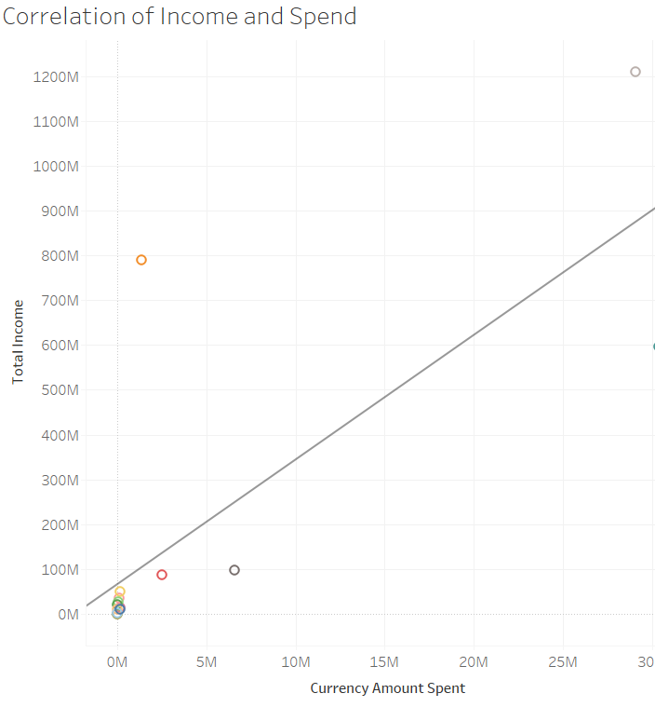
which specific segment would you like to target for this new product?
For my new product I would like to target the high-income earners that are married.
Why would you target them?
There is a strong correlation between the amount earned and amount spent(see fig), so the high earners are more likely to spend more, mostly through transfers. Also, high income earners with family are more likely to spend more at a single vendor on any activities.

Slide 23
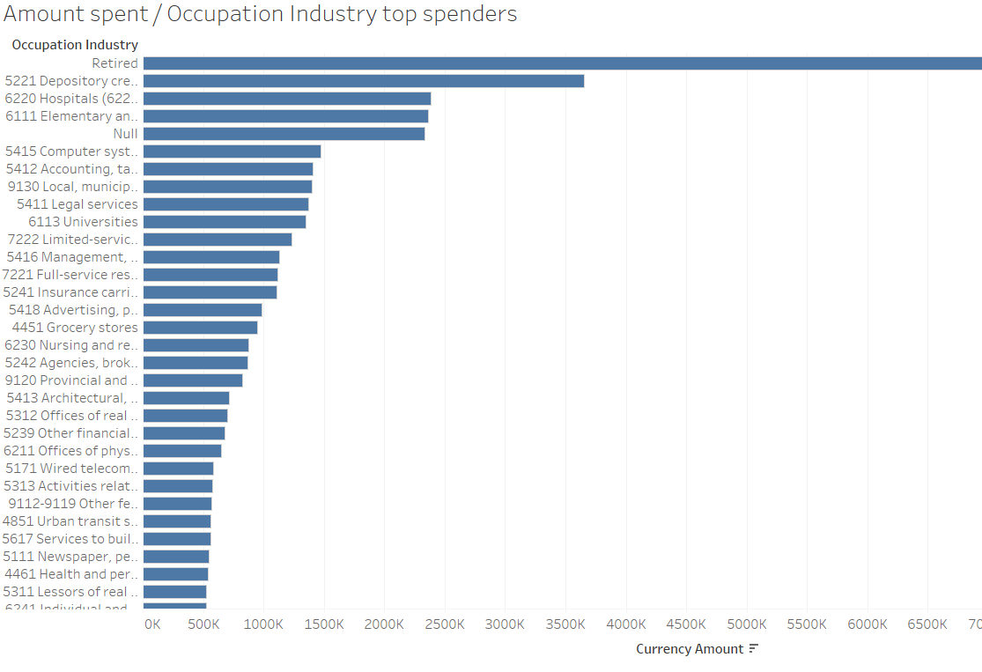
What are the potential challenges/risks to consider when targeting this segment vs. others?
High income earners tend to have a lot of options at their disposal for any particular product. So, the cost of acquisition of this customer segment is very high as we will have to spend more on adverts to convince them. However, since their buying decision is not based on price, this customer segment tend to be loyal to a particular product. Therefore, they have a higher lifetime value when compared to the low owners, who are always looking out for the next price deal.
However, consideration of the customers in the segment will have to take note of the industry of occupation of the customers, as the amount spent showed a relationship with the industry of occupation of the customers.

